Slide 1
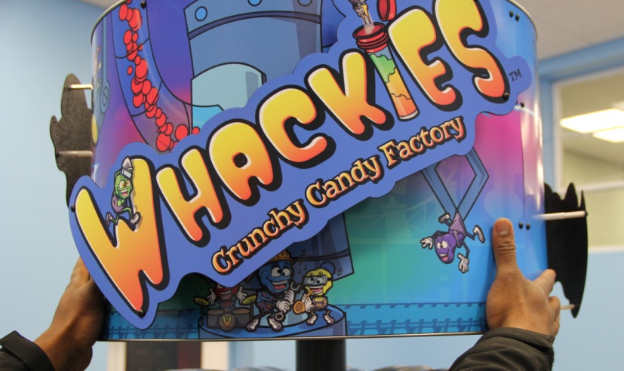
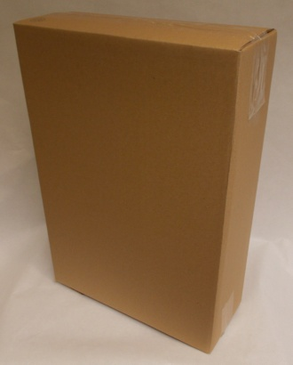
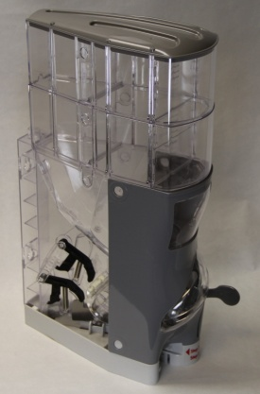
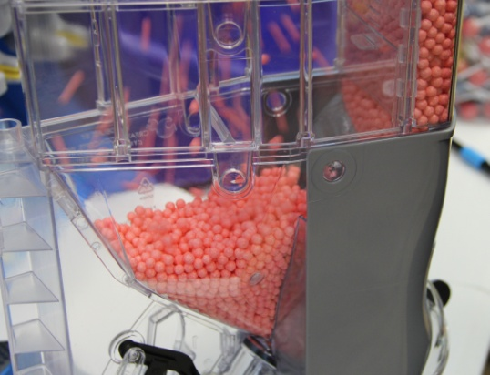
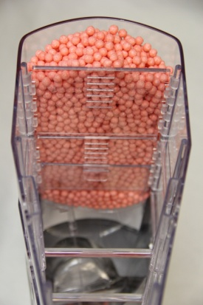
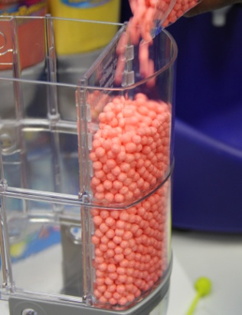
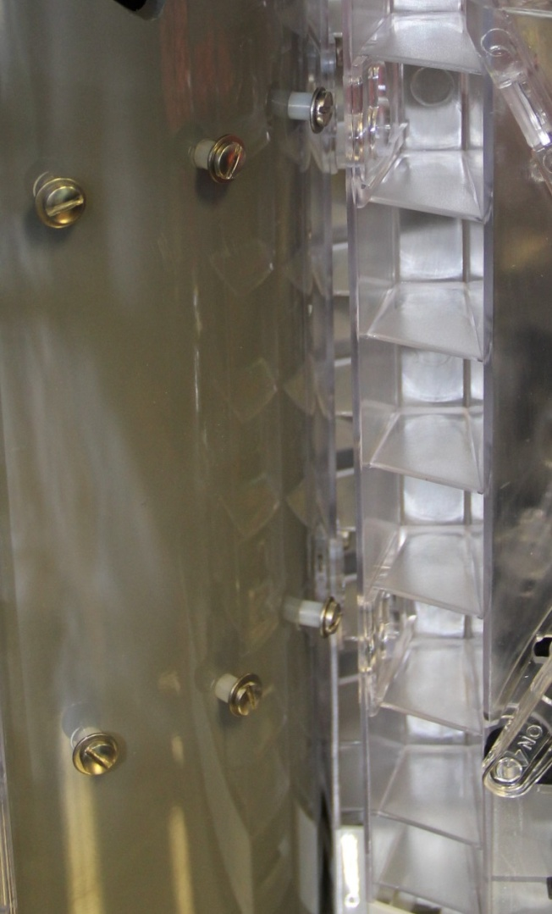
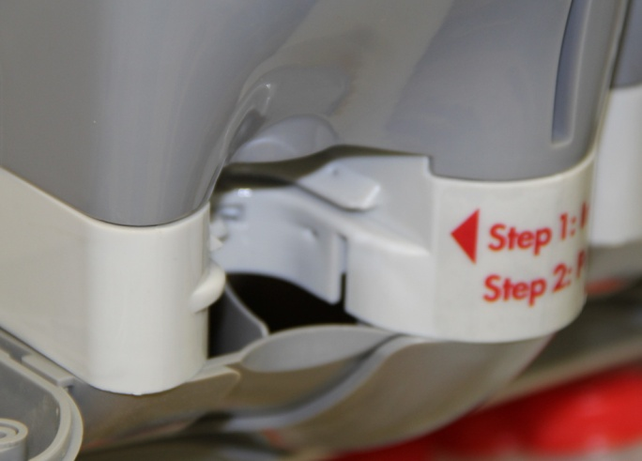
Whackies 8 Flavor Round User Manual
Rev. 1
1. Raise the header by twisting clockwise as shown. 2. Remove each dispenser from the boxes.
You can fill each dispenser before or after the dispenser is on the machine.
*WARNING DO NOT ATTEMPT TO MOVE MACHINE AFTER FILLING DISPENSERS *
Slide the false front door down if you prefer 5. Fill the hopper with remaining Whackies.
have candy stay in the false front area. If you
prefer to have the candy leave the false front
area, slide the door up.
Door is down
6. Line up the two key-hole slots on the back of 7. Line up the bottom of the dispenser to the catch
the dispenser with the support bolts on the tray.
machine. Slide the dispenser down.
Bottom of dispenser
Catch tray

Slide 2
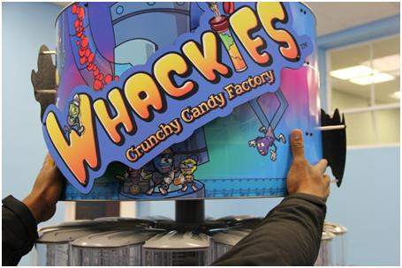
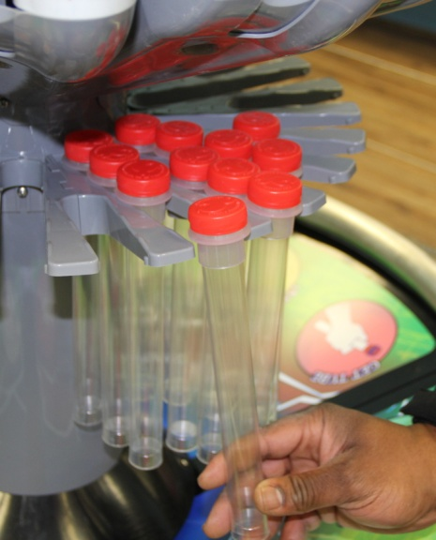
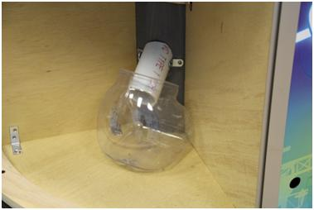
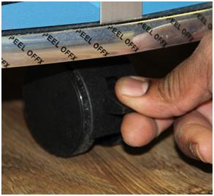
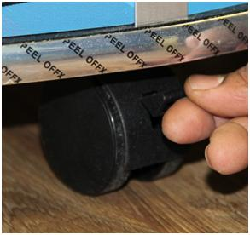
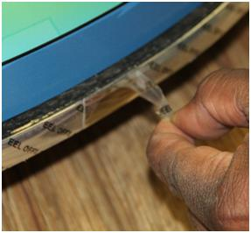
8. Complete steps 2-7 for the remaining dispensers. A total of 8 dispensers go on the machine.
Lower the sign by twisting counter-clockwise 10. Place tubes on tube holders.
so it rests on the top of the dispensers as shown.
11. One of the bottom compartments has a 12. To lock the machine in place, push down as shown.
receptacle that collects spilled candy (Indicated by
Sticker on pole .
have to be emptied from time to time.
13. Pull up on the tab to unlock the casters. 14. Remove the film off of the chrome trim at the
bottom of the machine.

Slide 3
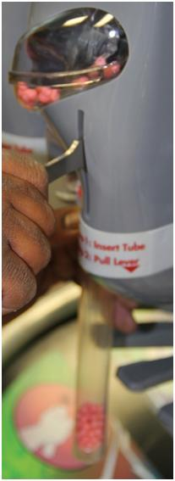
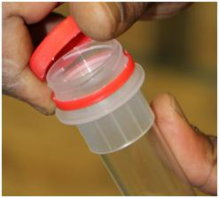
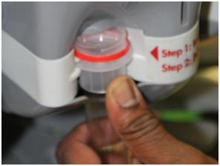
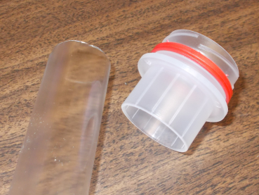
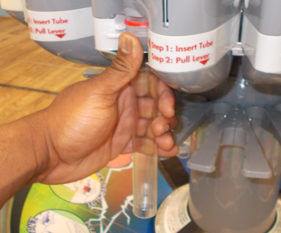
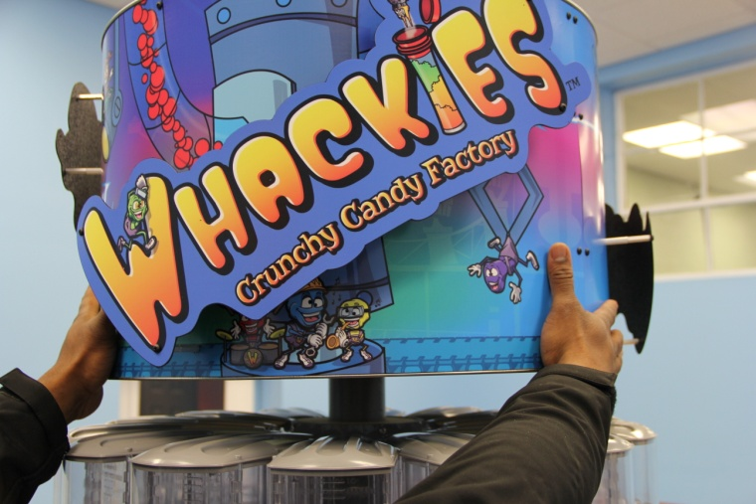
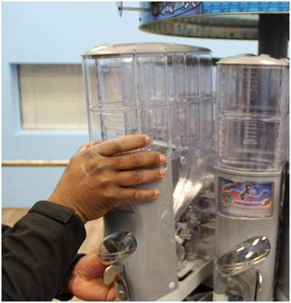
15. Remove the cap from tube and insert tube 16. While holding the tube to the dispenser pull down
into the opening of the dispenser. to dispense Whackies.
WRONG
CORRECT
17. To remove the dispenser(s) first raise the 18. Lift the dispenser straight up and then towards you
top by rotating the header clockwise. to remove it from the support bolts.
Then out
Up first
Creative Concepts, Inc.
1500 Georgia Road Building A
Irondale, AL 35210
Toll Free: (866) 838-0570 Fax: (205) 838-0999
puckerpowder.com

